Slide 1

Course Code : M23DE0106
Course Title: Python Programming
Academic Year & Semester:2024-2025(Odd Semester)​
Class: I MCA -A
Name of the Faculty: Md Abdul Kader Jailani
School of Computer Science & Applications
Unit-1

Slide 2
outline
Course Objectives
Course Contents
Learning Resources
TEXT BOOKS REFERENCE BOOKS
Course Outcomes
Computer Basics

Slide 3
COURSE OBJECTIVES
1.To learn Syntax and Semantics of Python language and understand and apply the various data structures in solving computational problems
2. To understand usage of NumPy and Pandas libraries
3. To learn handling files, functions and exceptions
4. To understand OOPs concepts in python and be able to draw various kinds of data visualization techniques using PyLab,matplotlib and Pandas

Slide 4
COURSE OBJECTIVES
1. To learn Syntax and Semantics of Python language and understand and apply the various data structures in solving computational problems
2. To understand usage of NumPy and Pandas libraries
3. To learn handling files, functions and exceptions
4. To understand OOPs concepts in python and be able to draw various kinds of data visualization techniques using PyLab, matplotlib and Pandas

Slide 5


Syllabus
Unit -I
INTRODUCTION TO PYTHON
Introduction to Python, Python History, Introduction to Object-oriented Programming, features of OOPs, Features of Python, “Hello world” program in Python, Keywords, Identifiers, Reading input
Data Types: Numeric data types - int, float, complex, Strings: Understanding string in build methods and Operations[slicing], Lists and its operations, Tuples and its operations, Dictionaries and Sets operations.
Operators in Python - Conditional blocks using if, else and elif, Simple for loops in python, For loop using ranges, Use of while and do while-loop in python, Loop manipulation using pass, continue, break and else.
04

Slide 6
Unit -II
USING NUMPY & PANDAS
Basics of NumPy-Computation on NumPy-Aggregations-Computation on Arrays- Comparisons, Masks and Boolean Arrays-Fancy Indexing-Sorting, Arrays-Structured Data: NumPy’s Structured Array.
Introduction to Pandas Objects-Data indexing and Selection-Operating on Data in Pandas- Handling Missing Data-Hierarchical Indexing - Combining Data Sets.
Unit -III
FUNCTIONS, EXCEPTION, AND FILES
Functions: Types, parameters, arguments: positional arguments, keyword arguments, parameters with default values, functions with arbitrary arguments, Scope of variables: Local and global scope, Recursion andLambda functions. Function Decorators, Generators
Structured Programming, Exceptions, Exception Handling, Types of Exceptions, The Except Block, the assert Statement, UserDefined Exceptions, Logging the Exceptions
Files: Files, Types of Files in Python, Opening a File, Closing a File, Working with Text Files Containing Strings, Knowing Whether a File Exists or Not, Working with Binary Files, The with Statement, Pickle inPython, The seek() and tell() Methods
04

Slide 7
Unit -IV
OOPS and VISUALIZATION
Object-oriented Programming in Python: Classes, Objects, Instances, Abstract Data Types and classes, Inheritance, Encapsulation and Information hiding, Polymorphism
Basic functions of matplotlib-Simple Line Plot, Scatter Plot-Density and Contour Plots- Histograms, Binning and Density-Customizing Plot Legends, Colour Bars-Three- Dimensional Plotting in Matplotlib
Multithreaded Programming: Introduction, Threads and Processes, Python Threads, and the Global Interpreter Lock, Thread Module, Threading Module, Related Modules
04

Slide 8
TEXT BOOKS
1 | Wesley J. Chun, - Core Python Programming, Second Edition, Pearson.
2 | Jake Vander Plas, Python Data Science Handbook - Essential Tools for Working with Data, O’Reily Media, Inc, 2016
3 | Zhang.Y ,An Introduction to Python and Computer Programming, Springer Publications,2016
REFERENCE BOOKS / MOOCs
1 | Joel Grus, Data Science from Scratch First Principles with Python, O’Reilly Media,2016.
2 | T.R. Padmanabhan, Programming with Python, Springer Publications,2016
3 | "Python for Data Science", Cognitive Class, 2019. [Online]. Available: https://cognitiveclass.ai/courses/python-for-data-science/. [Accessed: 20- Jun- 2019].
4 | Robert Sedgewick, Kevin Wayne, Robert Dondero, Introduction to Programming in Python, Pearson
5 | Daniel Y Chen, Pandas for Everyone: Python Data Analysis, 1st Edition, Pearson
6 | Doug Hellmann, The python 3 standard Library by example, Pearson Education
04

Slide 9
Introduction to Python
Python Definition: Python is a high-level, general-purpose programming language known for its readability and simplicity. It was created by Guido van Rossum and first released in 1991. Python is designed to be easy to learn and has a clear and straightforward syntax, making it accessible for beginners while remaining powerful enough for experienced developers.
Python is an interpreted, interactive, object-oriented programming language.
It incorporates modules, exceptions, dynamic typing, very high level dynamic data types, and classes.
Python is portable: it runs on many Unix variants including Linux and macOS, and on Windows.
04

Slide 10
Python History
Python's history dates back to the late 1980s when Guido van Rossum, a Dutch programmer, began working on the language. The development of Python can be traced through several key milestones:
1989: Guido van Rossum starts working on Python during his Christmas holidays. He was inspired by the ABC language, which he had worked on at Centrum Wiskunde & Informatica (CWI) in the Netherlands.
1991: Python 0.9.0, the first official release, is published. This version included many features that are still present in modern Python, such as exception handling, functions, and modules.
1994: Python 1.0 is released. This version included features like lambda, map, filter, and reduce.
2000: Python 2.0 is released, introducing list comprehensions, garbage collection, and Unicode support.
04

Slide 11
2008: Python 3.0 (also known as Python 3000 or Py3k) is released. This was a major overhaul of the language, introducing backward-incompatible changes to address design flaws and improve consistency. Python 2 and Python 3 were developed in parallel for several years.
2020: Python 2 officially reaches its end-of-life on January 1, 2020. Python 3 becomes the primary focus for the Python community.
Python has continued to evolve, with new releases bringing improvements, features, and optimizations. The community around Python has played a crucial role in its success, contributing to the development of libraries, frameworks, and tools that make Python suitable for a wide range of applications.
04

Slide 12
Introduction to Object-oriented Programming
Object-oriented programming (OOP) is a programming paradigm that uses the concept of "objects" to structure code. It is based on the principles of encapsulation, inheritance, and polymorphism. The primary goal of OOP is to model real-world entities and their interactions in a software system, promoting modularity, reusability, and maintainability.
04

Slide 13
Objects:
  Objects are instances of classes, and they represent real-world entities that have both data (attributes) and behavior (methods).
  For example, in a banking application, a "Customer" class could have attributes like name, account number, and balance, along with methods like deposit and withdraw.
Classes:
  A class is a blueprint or a template for creating objects. It defines the common structure and behavior that its instances (objects) will have.
  Using the example above, the "Customer" class would define the attributes (name, account number, balance) and methods (deposit, withdraw).
04

Slide 14
Features of OOPs
Python's object-oriented programming system supports all four features: encapsulation, abstraction, inheritance and polymorphism.
Encapsulation
Encapsulation is a mechanism where the data (variables) and the code (methods) that act on the data will bind together. For example, if we take a class, we write the variables and methods inside the class. Thus, class is binding them together. So class is an example for encapsulation.
For example, we can write a Student class with 'id' and 'name' as attributes along with the display() method that displays this data. This Student class becomes an example for encapsulation.
class Student:
def __init__(self):
self.id = 10
self.name = 'Raju'
#display students details
def display(self):
print(self.id)
print(self.name)
04

Slide 15
Abstraction
Abstraction is used to hide the internal functionality of the function from the users. The users only interact with the basic implementation of the function, but inner working is hidden.
we all use the smartphone and very much familiar with its functions such as camera, voice-recorder, call-dialing, etc., but we don't know how these operations are happening in the background. Let's take another example - When we use the TV remote to increase the volume. We don't know how pressing a key increases the volume of the TV. We only know to press the "+" button to increase the volume.
04

Slide 16
Inheritance
Inheritance allows a class (subclass or derived class) to inherit the properties and behaviors of another class (superclass or base class).
It promotes code reuse and the creation of a hierarchical structure. Common attributes and methods can be defined in a base class and inherited by multiple subclasses.
Polymorphism
The word 'Polymorphism' came from two Greek words 'poly' meaning 'many' and 'morphos' meaning 'forms'. Thus, polymorphism represents the ability to assume several different forms. In programming, if an object or method is exhibiting different behavior in different contexts, it is called polymorphic nature. Polymorphism provides flexibility in writing programs in such a way that the programmer uses same method call to perform different operations depending on the requirement.
04

Slide 17
When a function can perform different tasks, we can say that it is exhibiting polymorphism
#a function that exhibits polymorphism
def add(a, b):
print(a+b)
#call add() and pass two integers
add(5, 10) #displays 15
#call add() and pass two strings
add("Core", "Python") #displays CorePython
04

Slide 18
Python availability
Python is opensource freely downloadable software
The latest Python source distribution is always available from python.org, at https://www.python.org/downloads/.
04

Slide 19
Features of Python
Python is a versatile and powerful programming language that is widely used in various domains. Here are some key features of Python:
Easy to Learn and Read:
  Python has a clean and readable syntax, making it easy for beginners to grasp the language quickly.
  The use of indentation for code blocks enhances readability.
High-Level Language:
  Python is a high-level language, which means it abstracts low-level details like memory management and provides a more straightforward interface for developers.
Interpreted Language:
  Python is an interpreted language, meaning that code can be executed directly without the need for compilation.

Slide 20
Dynamic Typing:
  Python is dynamically typed, allowing variables to change types during execution. This can lead to more flexible and concise code.
Object-Oriented Programming (OOP):
  Python supports object-oriented programming, encapsulation, inheritance, and polymorphism.
Standard Library:
  Python comes with a comprehensive standard library that includes modules and packages for a wide range of tasks, from networking to web development.
Community and Documentation:
  Python has a large and active community, which contributes to its growth and provides extensive documentation and support.

Slide 21
Cross-Platform Compatibility:
  Python is compatible with various operating systems, such as Windows, macOS, and Linux, making it a cross-platform language.
Dynamically Typed:
  Python is dynamically typed, which means you don't need to specify variable types explicitly. This can lead to more concise and flexible code.
Extensibility and Embeddability:
  Python can be easily extended with modules written in other languages, and it can be embedded in applications to provide scripting capabilities.
Versatility:
  Python is a general-purpose language used in various domains, including web development, data science, machine learning, artificial intelligence, automation, and more.

Slide 22
Community Support:
  The Python community is active and supportive, providing a wealth of resources, forums, and libraries to help developers.
Scalability:
  Python can be used for small scripts or large-scale applications. It scales well and is used in both small startups and large enterprises.
Libraries and Frameworks:
  Python has a rich ecosystem of libraries and frameworks that facilitate development in various domains. Examples include NumPy and pandas for data science, Flask and Django for web development, TensorFlow and PyTorch for machine learning, etc.
Open Source:
  Python is an open-source language, encouraging collaboration and contribution from developers worldwide.

Slide 23
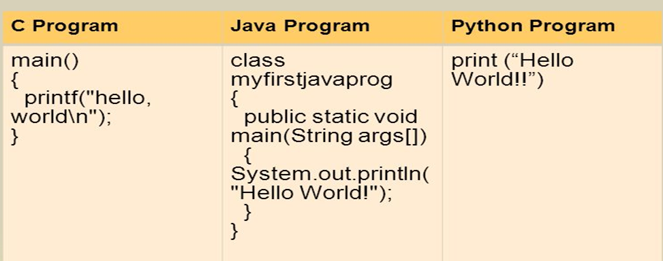
Comparison with other programming languages
04

Slide 24
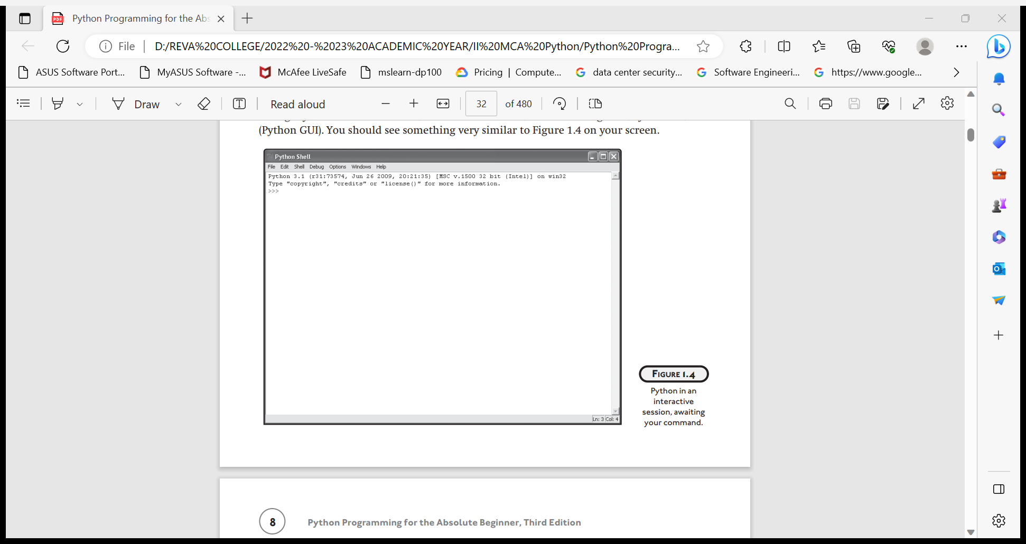
INTRODUCING IDLE
Python comes with an integrated development environment called IDLE. A development environment is a set of tools that makes writing programs easier.
Programming in Interactive Mode
Python’s IDLE also offers a script mode, in which you can write, edit, load, and save your programs. It’s like a word processor for your code.

Slide 25
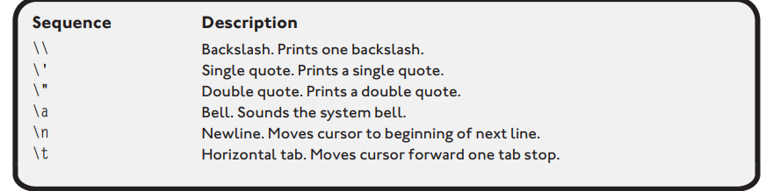
This window is called the Python Shell.
At the command prompt (>>>), type the commands
>>> is a primary prompt
… is a secondary prompt
SELECTED ESCAPE S EQUENCES

Slide 26
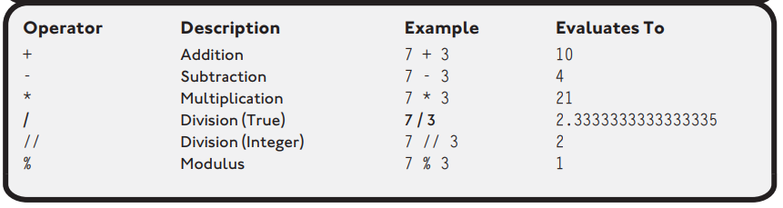
USEFUL MATHEMATICAL OPERATORS
USING QUOTES WITH STRINGS
Single Quotes ex: ‘Hello World’
Double Quotes ex: “Hello World”
Triple-Quoted strings Ex: “”” Hello world”””
04

Slide 27
Python Comments
Comments can be used to explain Python code.
Comments can be used to make the code more readable.
Comments can be used to prevent execution when testing code.
Ex: #This is a comment
print("Hello, World!")
Multiline Comments
Ex: #This is a comment
#written in
#more than just one line
print("Hello, World!")
OR
"""
This is a comment
written in
more than just one line
"""
print("Hello, World!")
04

Slide 28
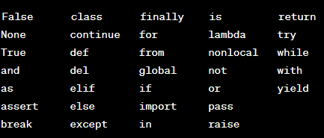
Keywords
Python has a set of reserved keywords that have specific meanings within the language and cannot be used as identifiers (such as variable names or function names).
These keywords are case-sensitive, so using uppercase or lowercase variations will be treated differently. Additionally, it's important to avoid using these words as identifiers to prevent conflicts and ensure the proper functioning of the Python code.
04

Slide 29
Key words
Reserved words
Keyword | Description
and | A logical operator
as | To create an alias
assert | For debugging
break | To break out of a loop
class | To define a class
continue | To continue to the next iteration of a loop
def | To define a function
del | To delete an object
elif | Used in conditional statements, same as else if

Slide 30
else | Used in conditional statements
except | Used with exceptions, what to do when an exception occurs
False | Boolean value, result of comparison operations
finally | Used with exceptions, a block of code that will be executed no matter if there is an exception or not
for | To create a for loop
from | To import specific parts of a module
global | To declare a global variable
if | To make a conditional statement

Slide 31
lambda | To create an anonymous function(function that is defined without a name)
None | Represents a null value
not | A logical operator
or | A logical operator
pass | A null statement, a statement that will do nothing
raise | To raise an exception
return | To exit a function and return a value
True | Boolean value, result of comparison operations
try | To make a try...except statement
while | To create a while loop
with | Used to simplify exception handling

Slide 32
Identifiers
Identifiers in Python are names given to entities in a program, such as variables, functions, classes, modules, or other objects. Here are the rules for creating identifiers in Python:
Character Set:
Identifiers can consist of letters (both uppercase and lowercase), digits, and the underscore (_) character.
Starting with a Letter or Underscore:
An identifier must start with a letter (a-z, A-Z) or an underscore (_).
Case-Sensitive:
Python is case-sensitive, so identifiers myVar and myvar are different.
No Special Characters:
Special characters like !, @, #, $, %, etc., are not allowed in identifiers.
04

Slide 33
Reserved Words:
  Identifiers cannot be the same as Python keywords or reserved words.
Length:
  There is no limit on the length of an identifier, but it's a good practice to keep it reasonably short and descriptive.
Examples of valid identifiers:
variable_name = 42
my_function = lambda x: x * 2
MyClass = MyClass()
Examples of invalid identifiers:
2variable = 42 # Starts with a digit
my-variable = 10 # Contains a hyphen
for = 5 # Reserved word
04

Slide 34
Reading Input in Python
In Python, you can read input from the user using the input() function. The input() function takes a string argument (which is a prompt) and displays it to the user. The program then waits for the user to enter some text and press Enter. The entered text is returned as a string.
Using input() function:
The input() function is the most common way to get user input. It reads a line from the console and returns it as a string.
user_input = input("Enter something: ")
print("You entered:", user_input)
04

Slide 35
Type Casting for Numeric Input:
If you need numeric input, you can use type casting functions like int() or float() to convert the input to the desired type.
user_number = int(input("Enter an integer: "))
print("You entered:", user_number)
Reading Multiple Inputs:
You can use the split() function to read multiple inputs in a single line and assign them to variables.
values = input("Enter two numbers separated by space: ").split()
num1, num2 = map(int, values)
print("You entered:", num1, "and", num2)
04

Slide 36
Reading File Input: If you want to read input from a file, you can open the file and read its contents.
with open("input_file.txt", "r") as file:
file_content = file.read()
print("File content:", file_content)
Type Casting for float Input:To receive float input from the user in Python, you can use the input() function and then convert the input to a float using the float() function. Here's an example:
# Reading a float from the user
user_float = float(input("Enter a floating-point number: "))
# Displaying the entered float
print("You entered:", user_float)
04

Slide 37
VARIABLES
Variables are containers for storing data values.
A variable is created the moment you first assign a value to it.
Variables do not need to be declared with any particular type, and can even change type after they have been set.
x = 5
y = "John"
print(x)
print(y)
You can get the data type of a variable with the type() function.
String variables can be declared either by using single or double quotes
Variable names are case-sensitive.
    x = 5
    y = "John"
    print(type(x))
04

Slide 38
Variable Names
A variable can have a short name (like x and y) or a more descriptive name (age, carname, total_volume). Rules for Python variables:A variable name must start with a letter or the underscore character
A variable name cannot start with a number
A variable name can only contain alpha-numeric characters and underscores (A-z, 0-9, and _ )
Variable names are case-sensitive (age, Age and AGE are three different variables)
A variable name cannot be any of the Python keywords.
04

Slide 39
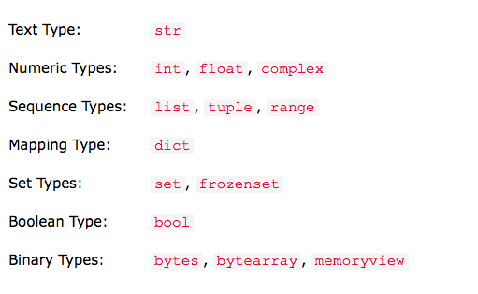
DATATYPES IN PYTHON

Slide 40
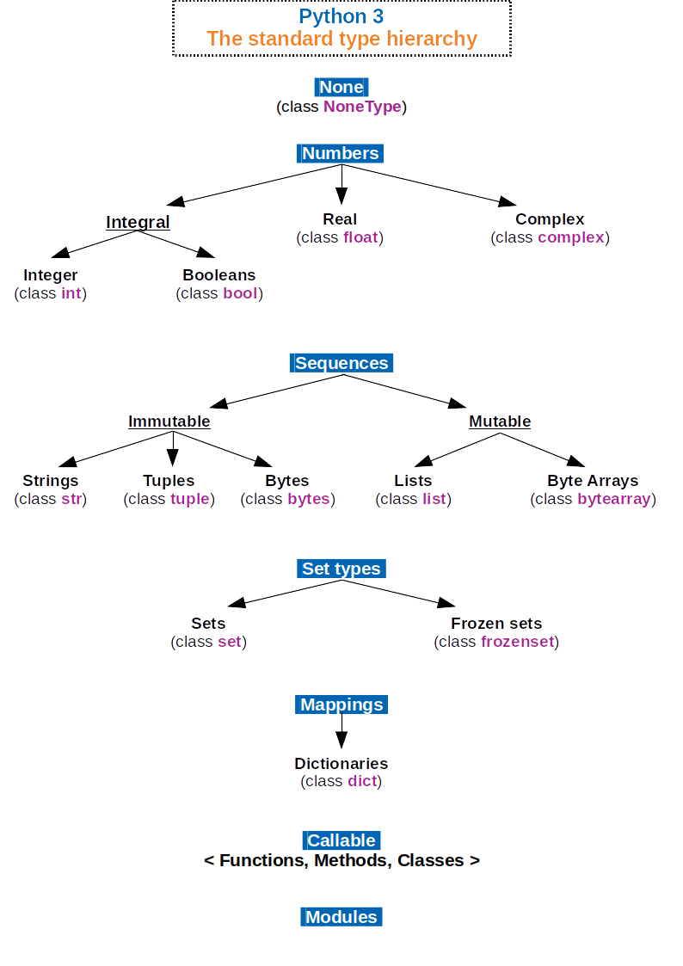

Slide 41
Python has several built-in data types that are fundamental to the language. Here are some of the commonly used data types in Python:
Numeric Types:
int: Integer type represent whole numbers, such as 5 or -10., e.g., x = 5.
float: Floating-point type represent decimal or fractional numbers, like 3.14 or -0.5., e.g., y = 3.14.
complex: complex number is a number of the form a + bj, where a and b are real numbers, and j is the imaginary unit (equal to the square root of -1). , e.g., z = 2 + 3j.
Sequence Types:
str: String type Store text and characters, like name = "John" or message = 'Hello, World!', e.g., text = "Hello, World!".
list: List type Contain ordered collection of items, like days = ["Monday", "Tuesday", "Wednesday"], e.g., my_list = [1, 2, 3].
tuple: Tuple type Similar to lists but are immutable, like coordinates = (10, 20)
, e.g., my_tuple = (1, 2, 3).
04

Slide 42
Set Types:
set: Set type Store unordered and unique values, like numbers = {1, 2, 3}, e.g., my_set = {1, 2, 3}.
Mapping Type:
dict: Dictionary type Store key-value pairs, such as person = {'name': 'Alice', 'age': 25} , e.g., my_dict = {'key': 'value'}.
Boolean Type:
bool: Boolean type represents truth values: True or False.
, either True or False.
FrozenSet: Similar to sets but are immutable, like vowels = frozenset(['a', 'e', 'i', 'o', 'u'])
04

Slide 43
Strings
A string is a sequence of characters used to represent text. In Python, strings are immutable sequences of Unicode code points. They can be created using single quotes (‘), double quotes (“), or triple quotes (‘’’ or “””). Strings in Python can be manipulated using various built-in methods and operations, including slicing.
Some commonly used string methods:
len():Returns the length of the string.
my_string = "Hello, World!"
length = len(my_string)
print("Length:", length)
2. upper() and lower():Converts all characters to uppercase or lowercase.
my_string = "Hello, World!"
uppercase_string = my_string.upper()
lowercase_string = my_string.lower()
print("Uppercase:", uppercase_string)
print("Lowercase:", lowercase_string)
04

Slide 44
3. capitalize() and title():Capitalizes the first character of the string or each word.
my_string = "hello world"
capitalized_string = my_string.capitalize()
title_case_string = my_string.title()
print("Capitalized:", capitalized_string)
print("Title Case:", title_case_string)
4. count(): Counts the occurrences of a substring in the string.
my_string = "Hello, Hello, Hello"
count_hello = my_string.count("Hello")
print("Count of 'Hello':", count_hello)
04

Slide 45
5. find() and index():Returns the index of the first occurrence of a substring. find() returns -1 if not found, while index() raises a ValueError.
my_string = "Hello, World!"
index_world = my_string.find("World")
print("Index of 'World':", index_world)
6. replace():Replaces occurrences of a substring with another string.
my_string = "Hello, World!"
new_string = my_string.replace("World", "Universe")
print("New String:", new_string)
7. split() and join():Splits a string into a list of substrings based on a delimiter. join() is used to concatenate a list of strings into one string.
my_string = "apple,orange,banana"
split_list = my_string.split(",")
joined_string = "-".join(split_list)
print("Split List:", split_list)
print("Joined String:", joined_string)
04

Slide 46
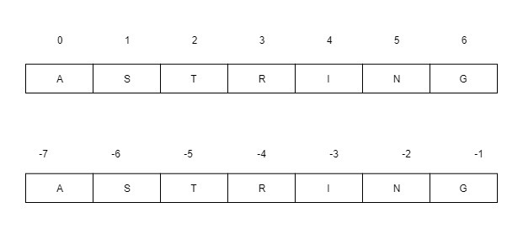
String Slicing
String slicing is a technique in Python that allows you to extract a portion (substring) of a string. It involves specifying a range of indices to create a new string containing the characters from the original string within that range.
Index tracker for positive and negative index: String indexing and slicing in python. Here, the Negative comes into consideration when tracking the string in reverse.
04

Slide 47
The general syntax for string slicing is as follows:
string[start:end:step]
start: The starting index of the substring (inclusive).
end: The ending index of the substring (exclusive).
step: The step or interval between characters (default is 1).
arr[start:stop] # items start through stop-1
arr[start:] # items start through the rest of the array
arr[:stop] # items from the beginning through stop-1
arr[:] # a copy of the whole array
arr[start:stop:step] # start through not past stop, by step
04

Slide 48
Example
# Example string
my_string = "Hello, World!"
# Basic slicing
substring1 = my_string[0:5] # characters from index 0 to 4 (5 is exclusive)
substring2 = my_string[7:12] # characters from index 7 to 11 (12 is exclusive)
print("Substring 1:", substring1)
print("Substring 2:", substring2)
# Omitting start or end
substring3 = my_string[:5] # characters from the beginning to index 4
substring4 = my_string[7:] # characters from index 7 to the end
print("Substring 3:", substring3)
print("Substring 4:", substring4)
04

Slide 49
# Negative indices
substring5 = my_string[-6:-1] # characters from index -6 to -2
print("Substring 5:", substring5)
# Using step
substring6 = my_string[0:10:2] # characters from index 0 to 9, skipping every second character
print("Substring 6:", substring6)
Output:
Substring 1: Hello
Substring 2: World
Substring 3: Hello
Substring 4: World!
Substring 5: World
Substring 6: Hlo,W
04

Slide 50
List & its Operations
The list is a sequence data type which is used to store the collection of data.
A list is a data structure in Python that is a mutable, or changeable, ordered sequence of elements. Each element or value that is inside of a list is called an item. Just as strings are defined as characters between quotes, lists are defined by having values between square brackets [ ].
Lists are used to store multiple items in a single variable.
List items are ordered, changeable, and allow duplicate values.
List items are indexed, the first item has index [0], the second item has index [1] etc.
04

Slide 51
program that includes various list operations:
# Creating a list
my_list = [1, 2, 3, 'a', 'b', 'c']
# Accessing elements
element = my_list[2]
print("Accessing elements:", element)
# Slicing
subset_list = my_list[1:4]
print("Slicing a list:", subset_list)
# Concatenating lists
new_list = my_list + [4, 5, 6]
print("List Concatenation:", new_list)
# Repeating a list
repeated_list = my_list * 2
print("List Repetition:", repeated_list)
# Appending an element to the end
my_list.append('d')
print("After Appending:", my_list)
# Extending the list with another iterable
my_list.extend([7, 8, 9])
print("After Extending:", my_list)
# Inserting an element at a specific index
my_list.insert(2, 'x')
print("After Inserting:", my_list)
# Removing the last element and returning it
last_element = my_list.pop()
print("Popped Element:", last_element)
print("After Popping Last Element:", my_list)
04

Slide 52
# Removing the element at a specific index
removed_element = my_list.pop(2)
print("Removed Element at Index 2:", removed_element)
print("After Removing Element at Index 2:", my_list)
# Removing the first occurrence of a value
my_list.remove('a')
print("After Removing 'a':", my_list)
# Finding the index of a specified value
index_b = my_list.index('b')
print("Index of 'b':", index_b)
# Checking if an element is in the list
is_in_list = 'a' in my_list
print("'a' in List:", is_in_list)
# Finding the length of a list
list_length = len(my_list)
print("List Length:", list_length)
# Iterating over elements in a list
print("Iterating Over Elements:")
for item in my_list:
print(item)
# List methods
count_a = my_list.count('a')
print("Count of 'a':", count_a)
# Reversing the order of elements in the list
my_list.reverse()
print("After Reversing:", my_list)
# Sorting the elements of a list
my_list.sort()
print("After Sorting:", my_list)
04

Slide 53
Tuples & its Operations
Python tuples are a type of data structure that is very similar to lists. The tuples are immutable, meaning they cannot be changed once they are created. This makes them ideal for storing data that should not be modified.
A tuple can have any number of items, which may be of different types, such as a string, integer, float, list, etc. Let's explore ways to create and use a tuple to make our programming tasks easier.
A tuple in Python is an ordered, immutable collection of elements. Once a tuple is created, you cannot modify its elements, and it is defined using parentheses ().
04

Slide 54
Program on tuple operation
# Creating a tuple
my_tuple = (1, 2, 3, 'a', 'b', 'c')
# Accessing elements
element = my_tuple[2]
print("Accessing elements:", element)
# Slicing
subset_tuple = my_tuple[1:4]
print("Slicing a tuple:", subset_tuple
# Concatenating tuples
new_tuple = my_tuple + (4, 5, 6)
print("Tuple Concatenation:", new_tuple)
# Repeating a tuple
repeated_tuple = my_tuple * 2
print("Tuple Repetition:", repeated_tuple)
# Finding the length of a tuple
tuple_length = len(my_tuple)
print("Tuple Length:", tuple_length)
# Checking if an element is in the tuple
is_in_tuple = 'a' in my_tuple
print("'a' in Tuple:", is_in_tuple)
# Iterating over elements in a tuple
print("Iterating Over Elements:")
for item in my_tuple:
print(item)
04

Slide 55
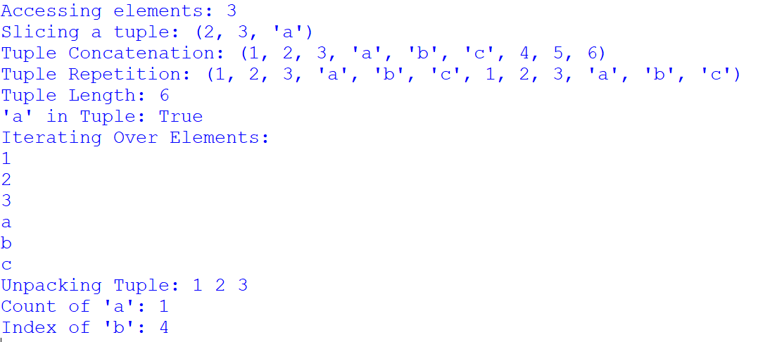
# Unpacking a tuple
first, second, third = my_tuple[:3]
print("Unpacking Tuple:", first, second, third)
# Tuple methods
count_a = my_tuple.count('a')
print("Count of 'a':", count_a)
index_b = my_tuple.index('b')
print("Index of 'b':", index_b)
04

Slide 56
Dictionaries & its operations
Dictionaries in Python are a built-in data type used to store collections of data in a key-value pair format. In Python, dictionaries are mutable, unordered, and indexed collections.
Each element in a dictionary is represented as a key-value pair, where the key is unique and the value can be of any data type such as integers, strings, lists, or even another dictionary.
Dictionaries are widely used in Python programming for tasks such as storing and retrieving data efficiently.
You can create a dictionary using curly braces {} and separating key-value pairs with colons :
Example
my_dict = {'key1': 'value1', 'key2': 'value2', 'key3': 'value3'}
04

Slide 57
Python program that demonstrates the use of pop(), popitem(), clear(), and del operations in dictionaries:
# Dictionary Initialization
my_dict = {'name': 'John', 'age': 25, 'city': ‘Bangalore', 'occupation': 'Engineer'}
# Using pop() to remove a specific key-value pair
removed_age = my_dict.pop('age')
print("After using pop('age'):", my_dict)
print("Removed age:", removed_age)
# Using popitem() to remove and return the last key-value pair
removed_item = my_dict.popitem()
print("\nAfter using popitem():", my_dict)
print("Removed item:", removed_item)
04

Slide 58
# Using clear() to remove all items from the dictionary
my_dict.clear()
print("\nAfter using clear():", my_dict)
# Reinitializing the dictionary
my_dict = {'name': 'John', 'age': 25, 'city': ‘Bangalore', 'occupation': 'Engineer'}
# Using del to remove a specific key-value pair
del my_dict['city']
print("\nAfter using del my_dict['city']:", my_dict)
#Combine two dictionaries
new_dict={‘state’=‘Karnataka’, ‘country’=‘India’}
my_dict.update(new_dict)
Print(‘\n after combining the elements of the dictionary are:”,my_dict)
# Using del to delete the entire dictionary
del my_dict
04

Slide 59
Output:
After using pop('age'): {'name': 'John', 'city': 'New York', 'occupation': 'Engineer'}
Removed age: 25
After using popitem(): {'name': 'John', 'city': 'New York'}
Removed item: ('occupation', 'Engineer')
After using clear(): {}
After using del my_dict['city']: {'name': 'John', 'age': 25, 'occupation': 'Engineer'}
04

Slide 60
Sets & its Operations
Sets in Python are unordered collections of unique elements. They are defined using curly braces {} or the set() constructor. Here's an overview of sets and some common operations:
Creating a Set: my_set = {1, 2, 3, 4, 5}
Adding Elements: my_set.add(6)
Removing Elements: my_set.remove(3) # Raises KeyError if the element is not present
my_set.discard(4) # Removes the element if present, otherwise does nothing.
4. Checking Membership: print(2 in my_set) # True
5. Set Operations:Union (|):
set1 = {1, 2, 3}
set2 = {3, 4, 5}
union_set = set1 | set2 # {1, 2, 3, 4, 5}
04

Slide 61
Intersection (&): intersection_set = set1 & set2 # {3}
Difference (-): difference_set = set1 - set2 # {1, 2}
Symmetric Difference (^): symmetric_difference_set = set1 ^ set2 # {1, 2, 4, 5}
6. Subset and Superset:
subset_check = {1, 2}.issubset(set1) # True
superset_check = set1.issuperset({1, 2}) # True
7. Clearing a Set: my_set.clear()
04

Slide 62
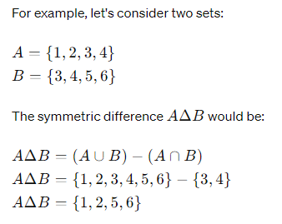
Symmetric difference

Slide 63
Frozen set
In Python, a frozen set is an immutable collection of unique elements, similar to a set but with the key difference that once a frozen set is created, its elements cannot be changed or modified.
Frozen sets are defined using curly braces {} with elements separated by commas. To create a frozen set in Python, you can use the frozenset() function.
Here is an example of creating a frozen set in Python:
# Creating a frozen set
frozen_set = frozenset([1, 2, 3, 4, 5])
print(frozen_set)
Frozen sets are useful when you want to create a collection of unique elements that should not be changed during the program’s execution. They are commonly used in situations where immutability and uniqueness are desired properties.

Slide 64
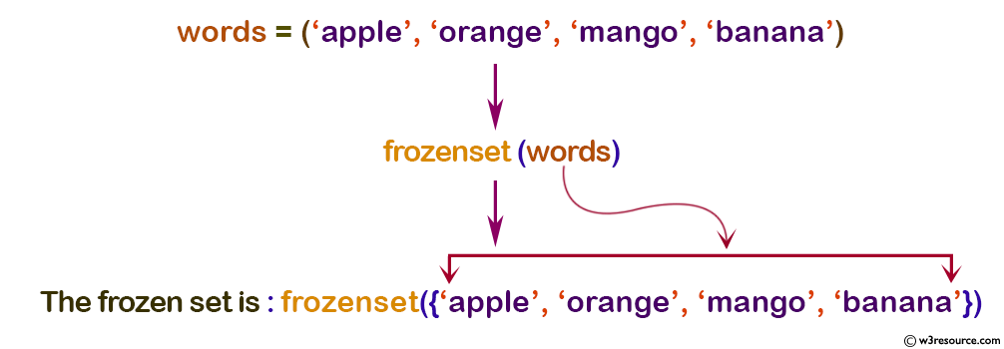
Example: Python frozenset() function
# tuple of words
words = ('apple', 'orange', 'mango', 'banana')
froSet = frozenset(words)
print('The frozen set is:', froSet)
print('The empty frozen set is:', frozenset())
Output:
The frozen set is: frozenset({'apple', 'mango', 'orange', 'banana'})
The empty frozen set is: frozenset()

Slide 65
OPERATORS IN PYTHON
Arithmetic operators
Assignment operators
Comparison operators/Relational operators
Logical operators
Identity operators
Membership operators
Bitwise operators

Slide 66
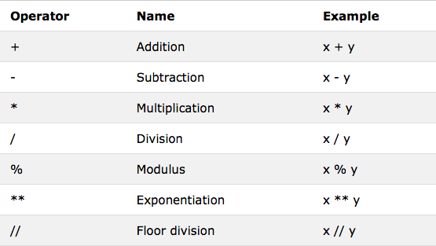
Arithmetic Operators

Slide 67
# Arithmetic Operators Program
# Initialize variables
num1 = 10
num2 = 3
# Display initial values
print("Initial values:")
print("num1 =", num1)
print("num2 =", num2)
# Arithmetic operators
addition_result = num1 + num2 # Addition
print("\nAddition Result:")
print("num1 + num2 =", addition_result)
subtraction_result = num1 - num2 # Subtraction
print("\nSubtraction Result:")
print("num1 - num2 =", subtraction_result)
multiplication_result = num1 * num2 # Multiplication
print("\nMultiplication Result:")
print("num1 * num2 =", multiplication_result)
division_result = num1 / num2 # Division
print("\nDivision Result:")
print("num1 / num2 =", division_result)
floor_division_result = num1 // num2 # Floor Division
print("\nFloor Division Result:")
print("num1 // num2 =", floor_division_result)
exponentiation_result = num1 ** num2 # Exponentiation
print("\nExponentiation Result:")
print("num1 ** num2 =", exponentiation_result)
modulus_result = num1 % num2 # Modulus
print("\nModulus Result:")
print("num1 % num2 =", modulus_result)

Slide 68
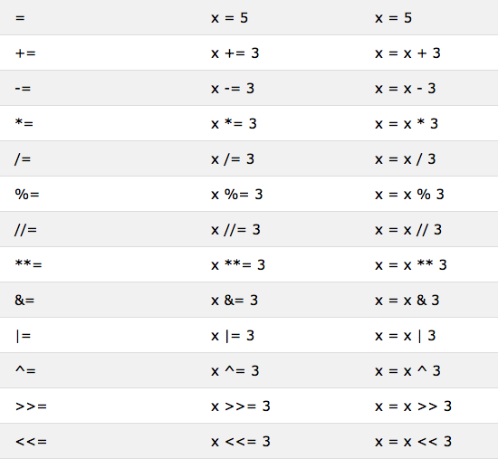
Assignment Operators

Slide 69
# Assignment Operators Program
# Initialize variables
a = 5
b = 2
# Display initial values
print("Initial values:")
print("a =", a)
print("b =", b)
# Assignment operators
a += b # Equivalent to a = a + b
print("\nAfter 'a += b':")
print("a =", a)
a -= b # Equivalent to a = a - b
print("\nAfter 'a -= b':")
print("a =", a)
a *= b # Equivalent to a = a * b
print("\nAfter 'a *= b':")
print("a =", a)
a /= b # Equivalent to a = a / b
print("\nAfter 'a /= b':")
print("a =", a)
a //= b # Equivalent to a = a // b
print("\nAfter 'a //= b':")
print("a =", a)
a **= b # Equivalent to a = a ** b
print("\nAfter 'a **= b':")
print("a =", a)
a %= b # Equivalent to a = a % b
print("\nAfter 'a %= b':")
print("a =", a)

Slide 70
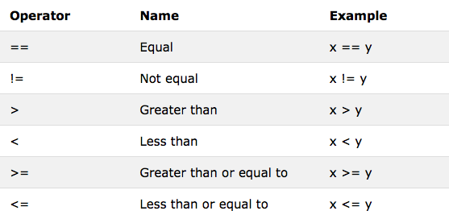
Comparison Operators

Slide 71
# Relational Operators Program
# Initialize variables
num1 = 10
num2 = 5
# Display initial values
print("Initial values:")
print("num1 =", num1)
print("num2 =", num2)
# Relational operators
equal_result = num1 == num2 # Equal to
print("\nEqual Result:")
print("num1 == num2 is", equal_result)
not_equal_result = num1 != num2 # Not equal to
print("\nNot Equal Result:")
print("num1 != num2 is", not_equal_result)
greater_than_result = num1 > num2 # Greater than
print("\nGreater Than Result:")
print("num1 > num2 is", greater_than_result)
less_than_result = num1 < num2 # Less than
print("\nLess Than Result:")
print("num1 < num2 is", less_than_result)
greater_than_equal_result = num1 >= num2 # Greater than or equal to
print("\nGreater Than or Equal Result:")
print("num1 >= num2 is", greater_than_equal_result)
less_than_equal_result = num1 <= num2 # Less than or equal to
print("\nLess Than or Equal Result:")
print("num1 <= num2 is", less_than_equal_result)

Slide 72
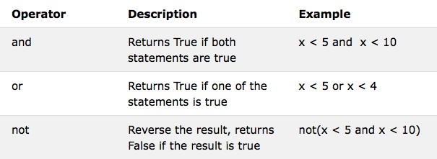
Logical Operators

Slide 73
# Logical Operators Program
# Initialize variables
value1 = True
value2 = False
# Display initial values
print("Initial values:")
print("value1 =", value1)
print("value2 =", value2)
# Logical operators
and_result = value1 and value2 # Logical AND
print("\nLogical AND Result:")
print("value1 and value2 is", and_result)
or_result = value1 or value2 # Logical OR
print("\nLogical OR Result:")
print("value1 or value2 is", or_result)
not_result1 = not value1 # Logical NOT for value1
not_result2 = not value2 # Logical NOT for value2
print("\nLogical NOT Results:")
print("not value1 is", not_result1)
print("not value2 is", not_result2)

Slide 74
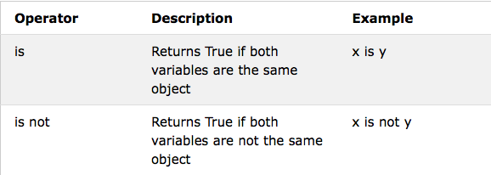
Identity Operators

Slide 75
# Identity Operators Program
# Initialize variables
x = 5
y = 5
z = [1, 2, 3]
w = [1, 2, 3]
# Display initial values
print("Initial values:")
print("x =", x)
print("y =", y)
print("z =", z)
print("w =", w)
# Identity operators
is_result1 = x is y # 'is' operator (checks if x and y reference the same object)
print("\n'is' Operator Result:")
print("x is y is", is_result1)
is_result2 = z is w # 'is' operator with lists
print("\n'is' Operator Result with Lists:")
print("z is w is", is_result2)
is_not_result1 = x is not y # 'is not' operator
print("\n'is not' Operator Result:")
print("x is not y is", is_not_result1)
is_not_result2 = z is not w # 'is not' operator with lists
print("\n'is not' Operator Result with Lists:")
print("z is not w is", is_not_result2)

Slide 76
'is' Operator Result:
x = 5
y = 5
x is y # Expected: True
The 'is' operator checks if two variables reference the same object. In this case, both x and y have the same value (5), and since small integers and some other immutable objects are cached in Python, x and y may reference the same object. So, the result is True.
'is not' Operator Result:
x = 5
y = 5
x is not y # Expected: False
Similar to the first case, since small integers are cached in Python, x and y may reference the same object. Therefore, the result is False.

Slide 77
'is' Operator Result with Lists:
z = [1, 2, 3]
w = [1, 2, 3]
z is w # Expected: False
Lists are mutable objects in Python, and even if they have the same elements, they are different objects in memory. Therefore, the result is False.
'is not' Operator Result with Lists:
z = [1, 2, 3]
w = [1, 2, 3]
z is not w # Expected: True
As explained earlier, lists are mutable, and even though they have the same elements, they are different objects in memory. Therefore, the result is True.

Slide 78
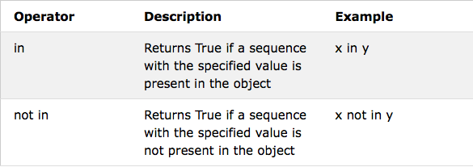
Membership Operators

Slide 79
# Membership Operators Program
# Initialize variables
list_example = [1, 2, 3, 4, 5]
set_example = {5, 6, 7, 8, 9}
# Display initial values
print("Initial values:")
print("list_example =", list_example)
print("set_example =", set_example)
# Membership operators
in_list_result = 3 in list_example # 'in' operator (checks if an element is present in a list)
print("\n'in' Operator Result for List:")
print("3 in list_example is", in_list_result)
not_in_list_result = 6 not in list_example # 'not in' operator for list
print("\n'not in' Operator Result for List:")
print("6 not in list_example is", not_in_list_result)
in_set_result = 7 in set_example # 'in' operator for set
print("\n'in' Operator Result for Set:")
print("7 in set_example is", in_set_result)
not_in_set_result = 10 not in set_example # 'not in' operator for set
print("\n'not in' Operator Result for Set:")
print("10 not in set_example is", not_in_set_result)

Slide 80
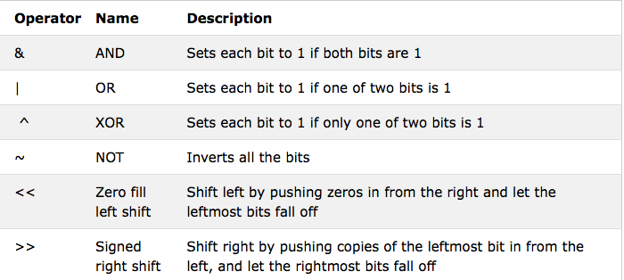
Bitwise Operators

Slide 81
xor_result = num1 ^ num2 # Bitwise XOR
print("\nBitwise XOR Result:")
print("num1 ^ num2 =", xor_result)
not_result = ~num1 # Bitwise NOT
print("\nBitwise NOT Result:")
print("~num1 =", not_result)
left_shift_result = num1 << 1 # Left Shift
print("\nLeft Shift Result:")
print("num1 << 1 =", left_shift_result)
right_shift_result = num1 >> 1 # Right Shift
print("\nRight Shift Result:")
print("num1 >> 1 =", right_shift_result)
# Bitwise Operators Program
# Initialize variables
num1 = 5 # binary: 0101
num2 = 3 # binary: 0011
# Display initial values
print("Initial values:")
print("num1 =", num1)
print("num2 =", num2)
# Bitwise operators
and_result = num1 & num2 # Bitwise AND
print("\nBitwise AND Result:")
print("num1 & num2 =", and_result)
or_result = num1 | num2 # Bitwise OR
print("\nBitwise OR Result:")
print("num1 | num2 =", or_result)

Slide 82
CONTROL STATEMENTS
If
If-Else
If-elif-else
Nested If-Else
For
Nested For

Slide 83
IF
The if statement checks the condition and executes the ‘if’ block of code when the condition is True,
Syntax :
if condition:
statement 1
statement 2

Slide 84
IF
Program :
# Program to check if a number is positive, negative, or zero
num = float(input("Enter a number: "))
if num > 0:
print("The number is positive.")
if num < 0:
print("The number is negative.")
if num == 0:
print("The number is zero.")

Slide 85
IF-ELSE
The if-else statement checks the condition and executes the ‘if’ block of code when the condition is True, and if the condition is False, it will execute the else block of code.
Syntax :
if condition:
statement 1
else:
statement 2

Slide 86
IF-ELSE
Program :
n = int(input("Enter Number to find ODD or EVEN : ")) if(n%2==0):
print(n,"is Even")
else:
print(n,"is Odd")

Slide 87
Program 2
# Program to check if a number is positive, negative, or zero
num = float(input("Enter a number: "))
if num > 0:
print("The number is positive.")
else:
if num < 0:
print("The number is negative.")
else:
print("The number is zero.")

Slide 88
IF-ELIF-ELSE
The if-elif-else condition statement has an ‘elif’ keyword used to chain multiple condition one
after another. The if-elif-else is useful when you need to check multiple conditions.
Syntax :
if condition-1:
statement 1 elif condition-2:
statement 2 elif condition-3:
statement 3
else:
statement

Slide 89
# Program to check if a number is positive, negative, or zero
num = float(input("Enter a number: "))
if num > 0:
print("The number is positive.")
elif num < 0:
print("The number is negative.")
else:
print("The number is zero.")

Slide 90

IF-ELSE
Program :
n = int(input("Enter Marks to find GRADE : "))
if n > 90:
print("Your Grade is A1") elif n > 70:
print("Your Grade is B1")
elif n > 80:
print("Your Grade is A2") elif n > 60:
print("Your Grade is B2") elif n > 50:
print("Your Grade is C1")
elif n > 40:
print("Your Grade is C2") elif n > 32:
print("Your Grade is D") elif n > 20:
print("Your Grade is E1 (Fail)") else:

Slide 91
NESTED IF-ELSE
The Nested If-Else statement is an if statement inside another ‘if-else’ statement.
It is allowed in Python to put any number of if statements in another if statement.
Syntax :
if conditon_outer:
if condition_inner:
statement of nested if
else:
statement of nested if else #statement of outer if
else:
statement of outerelse #statement outside if block

Slide 92
# Example: Program to check if a number is prime or not
num = int(input("Enter a number: "))
# check if the number is greater than 1
if num > 1:
# check for factors
for i in range(2, num):
if (num % i) == 0:
count=1
break # exit the loop if a factor is found
else:
count=0
if count==1:
print(num, "is not a prime number")
else:
print(num, "is a prime number")
else:
print(num, "is not a prime number")

Slide 93
# Program to determine if a number is even or odd, and if it's positive, negative, or zero
num = int(input("Enter a number: "))
if num >= 0:
if num == 0:
print("The number is zero.")
else:
print("The number is positive.")
if num % 2 == 0:
print("The number is even.")
else:
print("The number is odd.")
else:
print("The number is negative.")

Slide 94
NESTED IF-ELSE
# Program to check if a given year is a leap year or not using nested if-else
year = int(input("Enter a year: "))
if year % 4 == 0:
if year % 100 == 0:
if year % 400 == 0:
print(year, "is a leap year.")
else:
print(year, "is not a leap year.")
else:
print(year, "is a leap year.")
else:
print(year, "is not a leap year.")

Slide 95
Explanation:
The outer if statement checks if the year is divisible by 4 without leaving a remainder. If the condition is true, it means the year could be a leap year, so it proceeds to the nested if statement.
Inside the nested if statement, it further checks if the year is divisible by 100. If it is, it could still be a leap year (e.g., 2000 is a leap year), so it proceeds to another nested if statement.
Inside the second nested if statement, it checks if the year is divisible by 400. If it is, it confirms that it's a leap year. If not, it's not a leap year.
If the year is not divisible by 100 in the first nested if statement, it skips the second nested if statement and directly concludes that it's a leap year.
If the year is not divisible by 4 in the outer if statement, it concludes that it's not a leap year.

Slide 96
FOR LOOP
A for loop is used for iterating over a sequence and iterables (like range, list, a tuple, a dictionary, a set or a string).
Syntax :
for i in range/sequence: statement 1
statement 2
statement n

Slide 97
# Example 1: Iterating over a range of numbers
for i in range(5):
print(i)
Output:
0
1
2
3
4
# Example 2: Iterating over elements of a list
fruits = ["apple", "banana", "cherry"]
for fruit in fruits:
print(fruit)
Output:
apple
banana
cherry

Slide 98
# Example 3: Iterating over characters of a string
word = "Python"
for char in word:
print(char)
Output:
P
y
t
h
o
n
# Example 4: Iterating over key-value pairs of a dictionary
person = {"name": "John", "age": 30, "city": "New York"}
for key, value in person.items():
print(key, ":", value)
Output:
name : John
age : 30
city : New York

Slide 99
# Example 5: Iterating over a sequence with a custom step size
for i in range(0, 10, 2):
print(i)
Output:
0
2
4
6
8

Slide 100
# Example 1: Summing the elements of a list
numbers = [1, 2, 3, 4, 5]
total = 0
for num in numbers:
total += num
print("Sum of numbers:", total)
Output:
Sum of numbers: 15

Slide 101
# Example 2: Counting the number of vowels in a string
text = "Hello, World!"
vowel_count = 0
for char in text:
if char.lower() in 'aeiou':
vowel_count += 1
print("Number of vowels:", vowel_count)
Output:
Number of vowels: 3

Slide 102
# Example 3: Printing a multiplication table
num = 5
print("Multiplication table of", num)
for i in range(1, 11):
print(num, "x", i, "=", num * i)
Output:
Multiplication table of 5
5 x 1 = 5
5 x 2 = 10
5 x 3 = 15
5 x 4 = 20
5 x 5 = 25
5 x 6 = 30
5 x 7 = 35
5 x 8 = 40
5 x 9 = 45
5 x 10 = 50

Slide 103
# Example 4: Finding the maximum element in a list
numbers = [10, 5, 20, 15, 25]
max_num = numbers[0]
for num in numbers:
if num > max_num:
max_num = num
print("Maximum number:", max_num)
Output:
Maximum number: 25

Slide 104
# Program to calculate the factorial of a number without using a function
# Input a number
number = int(input("Enter a number to calculate its factorial: "))
# Initialize the result variable to store the factorial
factorial = 1
# Calculate factorial using a for loop
for i in range(1, number + 1):
factorial *= i
# Print the factorial
print("The factorial of", number, "is:", factorial)

Slide 105
FOR LOOP
Program :
n , f = int(input("Enter Number to find PRIME or not : ")) , 0 for i in range(1,n+1):
if(n%i==0):
f+=1
if(f==2):
print(n,"is Prime")
else:
print(n,"is Not Prime")

Slide 106
NESTED FOR LOOP
A Nested For Loop is a For Loop Within Another For Loop
Syntax :
for element in sequence
for element in sequence: body of inner for loop
body of outer for loop other statements

Slide 107
NESTED FOR LOOP
Program :
rows = 5
for i in range(0, rows):
for j in range(0, i + 1): print("*", end=' ')
print("\r")

Slide 108
Control Structure
1. Iterative Statements
For loop
While Loop
Examples
2. Selection Statements
If Statements
If-Else Statements
Elif Statements

Slide 109
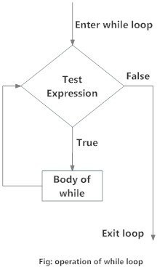
ITERATION
1. While loop:
The while statement repeats a body of code as long as a condition is true.
Syntax:
while test_expression:
Body of while

Slide 110
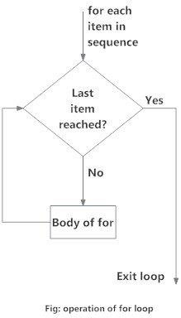
ITERATION
1. For Loop:
The for statement can be used to iterate over the members of a collection, so long as the
collection is a sequence. Syntax:
for iterator_var in sequence: statements(s)

Slide 111
ITERATING OVER A LIST:
>>>print("List Iteration")
>>>l = [“Manikanta", “Pradhan"]
>>>for i in l:
…. print(i)

Slide 112
ITERATING OVER A TUPLE:
>>>print(“Tuple Iteration")
>>>t = (“Manikanta", “Pradhan“)
>>>for i in t:
…. print(i)

Slide 113
ITERATING OVER A STRING:
>>>print(“Tuple Iteration")
>>>s = “Manikanta Pradhan”
>>>for i in s:
…. print(i)

Slide 114
ITERATING OVER A DICTIONARY:
>>>print("\nDictionary Iteration")
>>>d = dict()
>>>d['xyz'] = 123
>>>d['abc'] = 345
>>>for i in d :
…. print("%s %d" %(i, d[i]))

Slide 115
SELECTION STATEMENTS
Selection statements allow programmers to ask questions and then, based on the result, perform different actions.
Types:
  If statement:
The simple if statement allows the program to branch based on the evaluation of an expression.
Syntax:
>>>if condition :
statements or expression

Slide 116
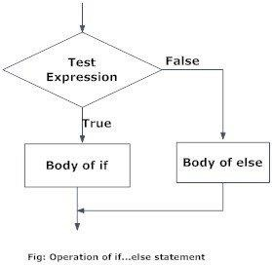
SELECTION STATEMENTS
1. If-else Statement:
The if-else statement evaluates test expression and will execute the body of
if only when the test condition is True. If the condition is False, the body of
else is executed.

Slide 117
SELECTION STATEMENTS
->>>If-else-if statements:
The elif is short for else if. It allows us to check for multiple expressions.
If the condition for if is False, it checks the condition of the next elif block and so on.
If all the conditions are False, the body of else is executed.
Only one block among the several if...elif...else blocks is executed according to the condition.
The if block can have only one else block. But it can have multiple elif blocks.

Slide 118
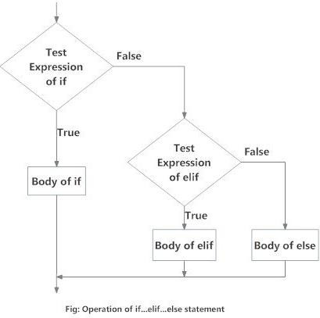
SELECTION STATEMENTS
1. Syntax:
if test expression:
Body of if
elif test expression:
Body of elif
else:
Body of else

Slide 119
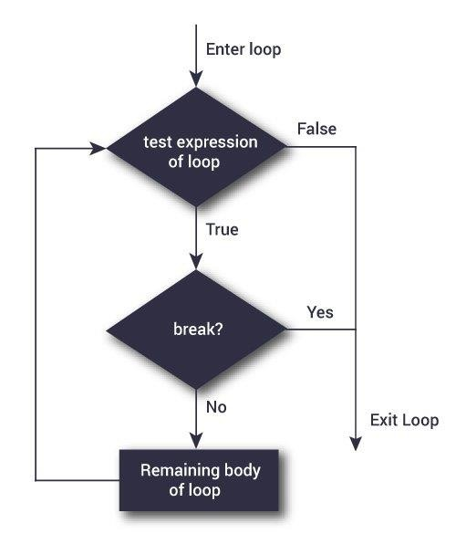
CONTROL STRUCTURES
1. Break Statement:
The break statement terminates the loop containing it. Control of the program flows
to the statement immediately after the body of the loop.

Slide 120
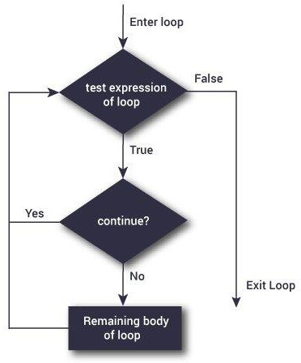
CONTROL STRUCTURES
1. Continue Statement:
The continue statement is used to skip the rest of the code inside a
loop for the current iteration only.
Loop does not terminate but continues with the next iteration.

Slide 121
CONTROL STRUCTURES
1. Pass Statement:
In Python programming, the pass statement is a null statement. The difference between a comment and a pass statement in Python is that while the interpreter ignores a comment entirely, pass is not ignored.

Slide 122
NESTED LOOP
Python programming language allows to use one loop inside another loop is called as nested loop
BASIC SYNTAX
outer loop:
inner loop:
statements of inner loop statements of outer loop

Slide 123
NESTED LOOP
When a loop is nested inside another loop. The inner loop runs many times inside the outer loop. Each iteration of the outer loop, the inner loop will be restarted.
The inner loop must finish all its iterations before the outer loop can continue to its next iteration.
It is used to deal with multiple condition in program.
These are typically used for working with two dimensions such as printing starts in rows and columns.

Slide 124
NESTED LOOP
Loops can be nested in following ways
For loop:
for loop:
while loop:
while loop:
For loop:
while loop:
While loop:
for loop:

Slide 125
NESTED FOR LOOP
For loop
where it falls under the category of definite iteration.
Definite iteration means the number of repetitions is specified explicitly in advance. Nested for loop
A nested for loop is a loop that occurs within another loop, structurally similar to nested if statements.

Slide 126
NESTED FOR LOOP
Syntax
For iterating_var1 in sequence: For iterating_var2 in sequence:
statements(s)
statements(s)

Slide 127
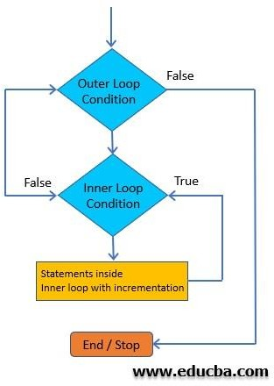
NESTED FOR LOOP

Slide 128
NESTED FOR LOOP
The program first encounters the outer loop, executing its first iteration. This first iteration triggers the inner, nested loop, which then runs to completion.
Then the program returns back to the top of the outer loop, completing the second iteration and again triggering the nested loop.
Again, the nested loop runs to completion, and the program returns back to the top of the outer loop until the sequence is complete or a break or other statement disrupts the process.

Slide 129
NESTED FOR LOOP
columns rows
*
**
***
****
1
2
3
4
1
*
* | *
* | * | *
* | * | * | *
2
3
4

Slide 130
num = int(input("enter the number of rows:")) for i in range(1,num+1):
for j in range(1,i+1): print("*", end=" ")
print()

Slide 131
WHILE NESTED LOOP
While loop we can executed a set of statements as long as a condition is true.
Python programming language allows the use of a while loop inside another while loop, it is known as nested while loop in Python programming language

Slide 132
WHILE NESTED LOOP
Syntax
While expression1: while expression2:
statements(s)
statements(s)

Slide 133
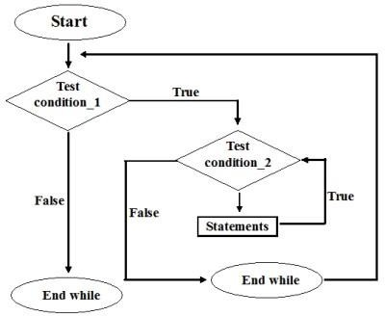
WHILE NESTED LOOP

Slide 134
WHILE NESTED LOOP
In the nested-while loop in Python, Two type of while statements are available: Outer while loop.
Inner while loop
Initially, Outer loop test expression is evaluated only once.
When its return true, the flow of control jumps to the inner while loop. the inner while loop executes to completion. However,
when the test expression is false, the flow of control comes out of inner while loop and executes again from the outer while loop only once. This flow of control persists until test expression of the outer loop is false.

Slide 135
NESTED WHILE LOOP
Thereafter, if test expression of the outer loop is false, the flow of control skips the execution and goes to rest.

Slide 136
NESTED WHILE LOOP
0
1
2
3
4
5
7
*
0
*
* *
1
* * *
*
*
* * * *
*
*
*
2
*
*
*
*
3

Slide 137
num = int(input("enter the number of rows :")) row = 0
while row<num: space = num-row-1 while space>0:
print(end=" ") space = space-1
star = row+1 while star>0:
print("*",end=" ") star= star-1
row = row+1 print()

Slide 138
INVERTED HOLLOW PATTERN
1 2
3
4
5
* | * | * | * | *
* |  |  | *
* |  | *
* | *
*
0
1
2
3
4

Slide 139
count =0
for i in range(5,0,-1): j=1
while(j<=i):
if(count == 0): print("*",end="") j+=1
elif(j == 1 or j== i): print("*",end="") j+=1
else:
print(" ",end="") j+=1
count+=1
print()

Slide 140
Control statements
BREAK
CONTINUE
PASS STATEMENTS

Slide 141

INTRODUCTION
You might face a situation in which you need to exit a loop completely when an external condition is triggered or there may also be a situation when you want to skip a part of the loop and start next execution.
Python provides break continue and pass statements to handle such situations and to have good control on your loop..

Slide 142
The break Statement
The break statement takes care of terminating the loop in which it is used. If the break statement is used inside nested loops, the current loop is terminated, and the flow will continue with the code followed that comes after the loop.

Slide 143
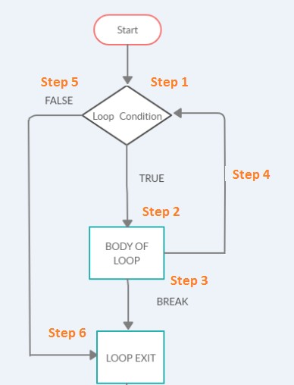
The flow chart for the break statement is as follows:

Slide 144
The following are the steps involved in the flowchart.
Step 1)
The loop execution starts.
Step 2)
If the loop condition is true, it will execute step 2, wherein the body of the loop will get executed.
Step 3)
If the loop's body has a break statement, the loop will exit and go to Step 6.
Step 4)
After the loop condition is executed and done, it will proceed to the next iteration in Step 4.
Step 5)
If the loop condition is false, it will exit the loop and go to Step 6.
Step 6)
End of the loop.

Slide 145
Programs:
# Use of break statement inside the loop
for val in "string":
if val == "i": break
print(val)
print("The end")
Output
s t r
The end

Slide 146
Program 2.
number=[10,20,30,0,5,0,30]
for n in number: if n==0:
break print('100/{}={}'.format(n,100/n))
Output 100/10=10.0
100/20=5.0
100/30=3.3333333333333335

Slide 147
format():
The format() method formats the specified value(s) and insert them inside the string's placeholder. The placeholder is defined using curly brackets: {}.
The format() method returns the formatted string.
Syntax
string.format(value1, value2...)

Slide 148
The placeholders can be identified using named indexes {price}, numbered indexes {0}, or even empty placeholders {}.
Example
print("my age is {}" .format(10))
print("my name is {} and my age is {}" .format(“Rani",20))

Slide 149
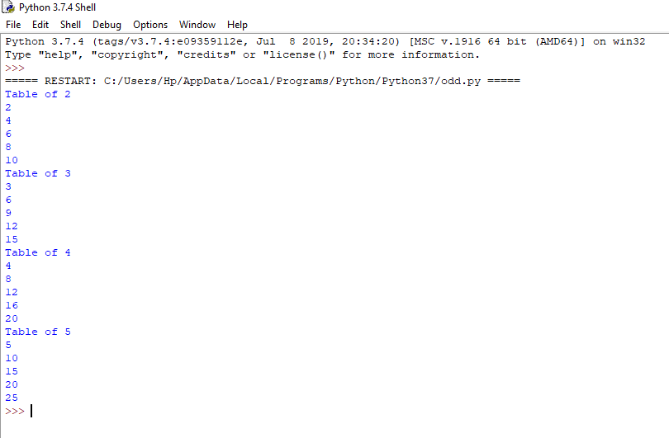
Program 3:
# printing table from 2 to 5, each table upto 5 iterations only for i in range(2,6):
print('Table of ',i) for j in range(1,11):
print(i*j) if (j == 5):
break

Slide 150
Program 4.
cart=[10,20,30,500,40,50]
for item in cart: if item>=500:
print("cant process this order")
break print(item)
else:
print("All items processed...")
print("out of for loop..")
Output 10
20
30
cant process this order out of for loop..

Slide 151
The continue Statement
The continue statement is used to skip the rest of the code inside a loop for the current iteration only. Loop does not terminate but continues on with the next iteration.

Slide 152
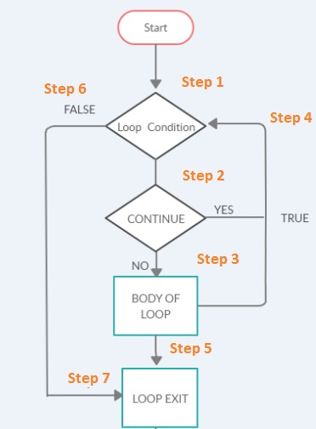
The flow chart for the continue statement is as follows:

Slide 153
The following are the steps involved in the flowchart.
Step 1)The loop execution starts.
Step 2)The execution of code inside the loop will be done. If there is a continued statement inside the loop, the control will go back to Step 4, i.e., the start of the loop for the next iteration.
Step 3)The execution of code inside the loop will be done.
Step 4)If there is a continue statement or the loop execution inside the body is done, it will call the next iteration.
Step 5)Once the loop execution is complete, the loop will exit and go to step 7.
Step 6)If the loop condition in step 1 fails, it will exit the loop and go to step 7.
Step 7)End of the loop.

Slide 154
Program 1.
for i in range(10): if i == 7:
continue
print("The Number is :" , i)
Output
The Number is : 0 The Number is : 1 The Number is : 2 The Number is : 3 The Number is : 4 The Number is : 5 The Number is : 6 The Number is : 8 The Number is : 9

Slide 155
Program 2.
cart=[10,20,30,500,40,50]
for item in cart: if item>=500:
print("cant process this order")
continue print(item)
else:
print("All items processed...")
print("out of for loop..")
Output 10
20
30
cant process this order 40
50
All items processed... out of for loop..

Slide 156
Program 3.
for i in range(4):
for j in range(4):
if j==2:
continue
print("The number is ",i,j);
Output
The number is 0 0
The number is 0 1
The number is 0 3
The number is 1 0
The number is 1 1
The number is 1 3
The number is 2 0
The number is 2 1
The number is 2 3
The number is 3 0
The number is 3 1
The number is 3 3

Slide 157
The pass Statement
The pass statement in Python is used when a statement is required syntactically but you do not want any command or code to execute.
The pass statement is a null operation; nothing happens when it executes.

Slide 158
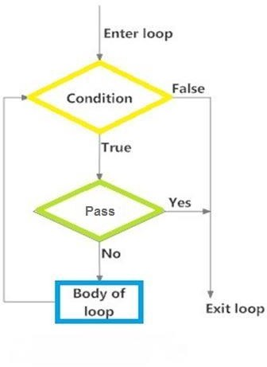
The flow chart for the break statement is as follows:

Slide 159
program1.
test = "reva" for i in test: if i == 'v':
print('Pass executed') pass
print(i)
Output r
e
Pass executed v
a

Slide 160

Thank You

